Slide 1

Moviesort
A skilled team delivering quality software solutions with precision and care.

Slide 2
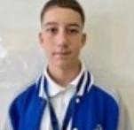

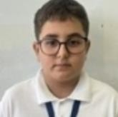
Meet the MovieSort Team
YaniSlav Todorov-Developer
Yanko Yanev-DeSigner/developer
RoStiSlav Ivanchev-scrum trainer

Slide 3
stageS of Work
Week 1:
Planned the website
Created the basic layout
Set up the project
Week 2:
Built the homepage
Added menu and sections
Made the site work on
phones and tablets
Added images and
animations
Week 3
Added login and
contact forms
Connected the database
Added website functions
Fixed bugs
Week 4
Tested the website
Improved speed and design
Uploaded the website
online
Made final changes and
completed the project

Slide 4




Communication & Productivity
MicroSoft TeamS
Real-time chat, video meetings, and file sharing keep everyone connected and informed throughout the day.
MicroSoft Word
Documentation hub for requirements, specifications, and detailed project documentation that everyone can access.
MicroSoft PoWerPoint
Creating presentations for stakeholder updates, project reviews, and knowledge sharing sessions.
GitHub
Central hub for collaboration, code reviews, issuetracking, and automated testing workflows.

Slide 5


THANK YOU FOR THE ATTENTION! NoW let'S check
the project

